Slide 1
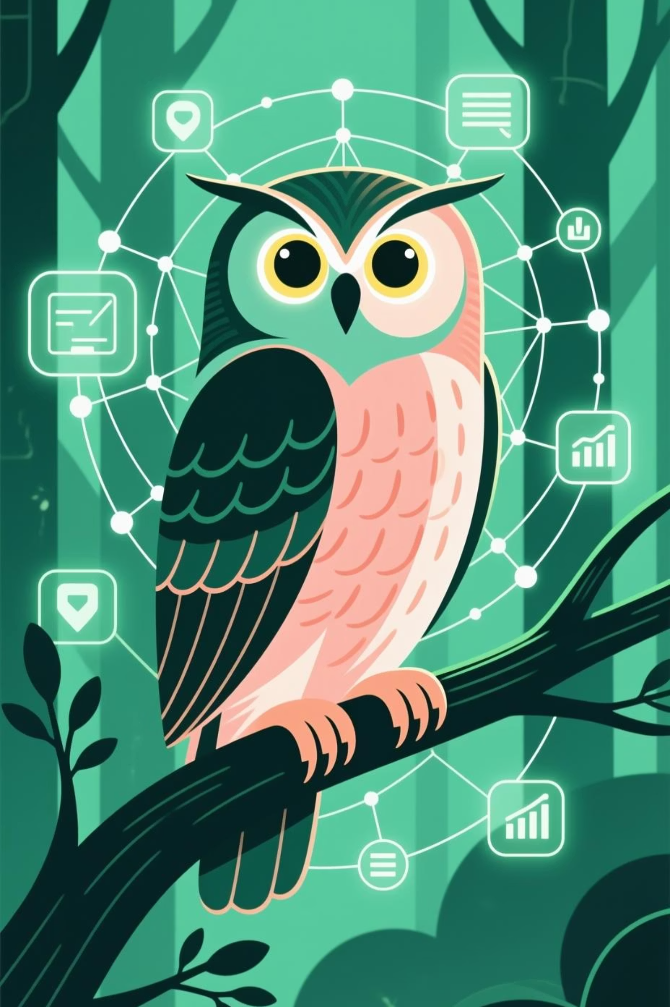
🦉 Web Owl Multi-Agent RAG System
Intelligent Website Navigation & Information Retrieval

Slide 2
1. Project Introduction
🎯 The Problem We Solve
Information Overload
Poor Search Results
Navigation Complexity
Users get lost in complex websites.
Generic search engines lack context.
Multi-step processes are confusing.
Fragmented Information
No Intelligent Guidance
Content scattered across multiple pages.
Users need step-by-step navigation help.
"A student wants to apply for a Master's program but spends hours clicking through different pages, downloading PDFs, and still misses crucial requirements buried in documentation."

Slide 3
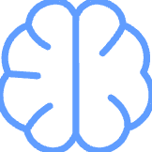


🦉 Introducing Web Owl
Intelligent Understanding
Multi-Agent Intelligence
Smart Navigation Guidance
Comprehends website structure, content hierarchies, and navigation patterns across multiple pages.
Four specialized AI agents work together, each with specific expertise and responsibilities, ensuring quality through multi-layer verification.
Provides step-by-step navigation paths, recommends optimal routes, and suggests related content based on user intent.

Slide 4

🎪 Project Scope & Vision
Target Applications:
Educational Institutions
Corporate Websites
Government Portals
Healthcare Systems
"First RAG system that doesn't just find information—it teaches users how to navigate and discover content intelligently."

Slide 5
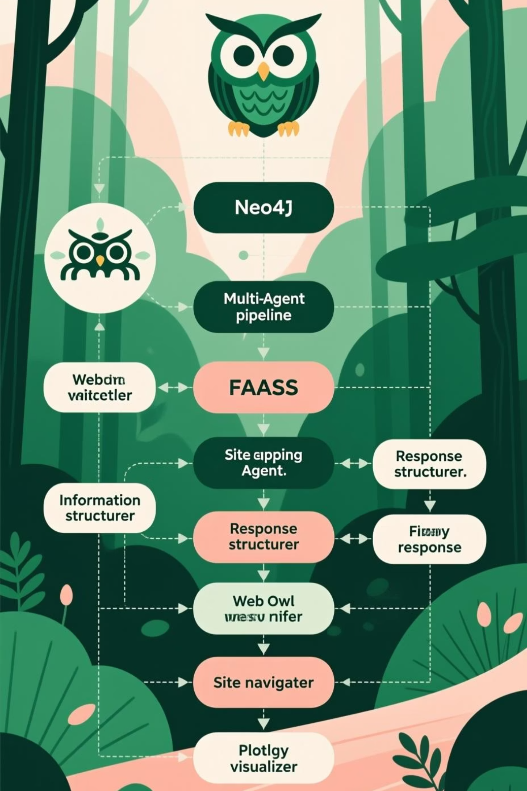
2. System Architecture & Innovation
🏗️ High-Level Architecture

Slide 6
💡 Core Innovation: Multi-Modal Knowledge Representation
Traditional RAG
Web Owl RAG
❌ Text chunks only
✅ Multi-modal content (HTML, PDF, images, tables)
❌ Flat document storage
✅ Rich graph relationships
❌ Simple similarity search
✅ Hybrid semantic + graph search
❌ Single-agent processing
✅ Multi-agent intelligence
❌ Information only
✅ Information + Navigation guidance

Slide 7
🔄 Data Flow & Processing Pipeline
01
02
03
Content Ingestion
Knowledge Preparation
Query Processing
Website URL → Intelligent Crawler → Multi-format Extraction → Content Classification → Relationship Mapping → Knowledge Graph
Graph Database → Text Chunking → Vector Embeddings → FAISS Index → Site Structure Analysis → Navigation Maps
User Query → Retrieval → Multi-Agent Processing → Response Generation

Slide 8
3. Technical Deep Dive
🕷️ Intelligent Web Crawler
Advanced Content Extraction
def extract_content(url, soup): content = {} # Multi-format support content["text"] = clean_text_extraction(soup) content["images"] = collect_images(soup) content["tables"] = extract_structured_tables(soup) content["pdfs"] = process_pdf_documents(soup) return content
Key Features:
Smart Content Classification
Relationship Mapping
PDF Intelligence
Depth-First Navigation

Slide 9
🧠 Neo4j Knowledge Graph Design
Sophisticated Schema
// Node Types(:Page {url, title, text_len})(:Asset {url, type, filename})(:Chunk {id, modality, text})// Rich Relationships(Page)-[:LINKS_TO]->(Page) // Navigation flow(Page)-[:CONTAINS]->(Asset) // Asset ownership(Page)-[:HAS_CHUNK]->(Chunk) // Content chunks(Asset)-[:HAS_CHUNK]->(Chunk) // Asset content
Advanced Capabilities:
Bidirectional Relationships
Content Versioning
Semantic Tagging

Slide 10
🔍 Hybrid Search Engine
Four Intelligent Search Modes
1. Semantic Search 🎯
2. Graph Walk Search 🌐
def semantic_search(self, query: str, top_k: int = 5): query_embedding = self.embedder.encode([query]) scores, indices = self.faiss_index.search(query_embedding, top_k) return self.enrich_results(indices, scores)
def graph_walk_search(self, query: str, max_depth: int = 2): return context_aware_results
3. Hybrid Search ⚡
4. Multimodal Search 🎭
Cross-format content discovery
def hybrid_search(self, query: str, semantic_weight: float = 0.7, graph_weight: float = 0.3): return best_of_both_worlds
Related asset identification
Comprehensive context building

